Slide 1
2023 Proposed Budget
Finance and Audit Committee
12/15/2022
Notes:
Ryan
Unmute
Good morning Chair Backus and members of the Finance and Audit Committee. My name is Ryan Fisher, Deputy Executive Director, Financial Planning, Analysis and Budget.

Slide 2
Why we are here
Request that the Finance and Audit Committee:
Advance Resolution No. R2022-35, recommended by other Committees, to the Board for adoption of the 2023 Budget and Transit Improvement Plan.

Slide 3
2023 budget and Transit Improvement Plan recommendations
Long-Range Financial Plan Projections 2017 - 2046
Including Sound Move, ST2, and ST3 sources and uses through 2046
Transit Improvement Plan to 2028
Board-approved costs for active projects through 2028
Budget 2023
Annual revenue, financing sources and expenditures for 2023

Slide 4
Budgets within Committee purview
Committee | Budget/TIP Sections
Rider Experience and Operations | Transit operations Non-system expansion projects
System Expansion | System expansion projects – Link, Sounder, Stride, and ST Express
Executive | System expansion projects – other (programs) Debt service and other costs
Finance and Audit Committee | Other committees recommend budget to FAC; FAC recommends to Board
Notes:
We are how at the Finance and Audit Committee portion of the budget process as seen in the green box.
We have conveyed the proposed budget to the Finance and Audit Committee back in October as well as the Board in November.
Additionally, the REO, System Expansion, and Executive Committees have reviewed the details of the budget within their purview and have now forwarded on their recommended budget to the Finance and Audit Committee.
In the next few slides I will recap the overall proposed 2022 budget for the Finance and Audit Committee to consider recommending to the Board.

Slide 5
2023 budget priorities
  Maintain long term financial sustainability
  Resource allocation consistent with August 2021 capital expansion resolution and agency DEIC priorities
  Operating resources to support new services and assets
  Service levels/budget reflect current ridership demand
Notes:
Initiatives are focused on cost consciousness
Multi-year targets are set for staffing and non-system expansion projects
We also built in affordability review to ensure majority of 2023 and beyond position adds are directly tied to system and service expansion
Nearly ¾ of our additional FTE growth is tied to activation and service and diversity, equity, inclusion, and culture headcount.
There are also additional FTEs for regulatory and compliance and technology functions.
We also streamlined, prioritized non-system expansion project reviews to focus on high-priority projects
2022 1,378 approved positions vs. 1,469 positions in 2023 (that’s 91 new positions)
ACTIVATION & REVENUE SERVICE – Activation and revenue service, Safety
56% of FTE growth (51 out of 91 FTEs) added in 2023 was activation & revenue service related
Diversity, Equity, Inclusion, and Culture (DEIC), Fare ambassadors
16% of FTE growth (15 of 91) 12 are in fare ambassadors
OTHER – Regulatory / compliance, Innovation and technology (Network Operations Center), Emerging needs
27% of FTE growth (25 out of 91)

Slide 6
Committee Recommendations

Slide 7
Proposed 2023 Budget
Revenues lower than expenditures, shortfall will be covered by existing cash balance.
*Other includes investment income, local & state contributions, rental car tax, and miscellaneous revenues.
*Other includes contributions to partner agencies, tax collection fees, leases and operating contingency.
Notes:
Overall, the proposed 2023 budget is at $3.1B for sources.
Revenues of $2.7 billion are $0.4B lower than expenditures of $3.1B. This shortfall will need to be covered by existing cash balances.
We expect to utilize existing cash from recent draws in 2022 that will be carried forward into 2023 as timing of project spending has shifted from original 2022 budget. We manage our cash in alignment with our Asset and Liability Management Policy.
Overall, uses of $3.1B is 2% above 2022 proposed budget.
We will recap each of these categories on the next few slides.
System expansion projects reduced by $55M, largely due reduction of $216.6M as Lynnwood Link and DRLE moved from their peak year of construction cost (in 2022), with increases driven mainly by 3 projects
$99.4M TDLE – Preparing for ROW activities and advancing design (OMFS) and continuing to advance DEIS (TDLE).
$97.6M I-405 BRT – Anticipate baseline in Q2 2023. , Complete Final Design, initiating procurement of systems and vehicles and continuing ROW acquisition and construction.
$50M WSBLE – Begin Ph3 PE and ROW activities.
Non-System Expansion projects (NSEP) increased by $66M, with $27M of new NSEP projects from new projects, and $48M increase change to existing projects off set by $(9)M going to transit modes.
Enhancement projects increased by $18M from 2022 budget with $12M for the new Portfolio Services Office Programmatic Work to support all agency-wide projects with engineering and station standards efforts.
State of good repair increased by $31M from 2022 budget. $6.5M comes from DSTT capital improvement activities, $4.2M for IT Tech infrastructure to upgrade servers at the data centers, and $3M for the vertical conveyance program to proceed with assessment and design of replacement elevators at Auburn, Kent and Everett stations.
Administrative projects are increasing $26M from 2022 budget with $21.3M increase mainly due to the impact of inflation, staffing , $3.1M in IT program to continue to address agency’s needs for IT systems, and $1.7M for office decommissioning.
The proposed transit operations budget has increase 15% from 2022 budget to $500M in the 2023 Proposed budget.
Link increased $40M, mainly due to Purchased Transportation, security, spare parts, and insurance.
Sounder increased $14M due to filling of vacancies expected in 2023, additional dollars for vehicles and facilities maintenance, and fuel costs.
Regional Express increased $7M mainly due to Purchased transportation with an increase in partners rates and higher fuel costs.
Tacoma Link increase of $6M is to account for revenue service of Hilltop Tacoma Link Extension in 2023.

Slide 8
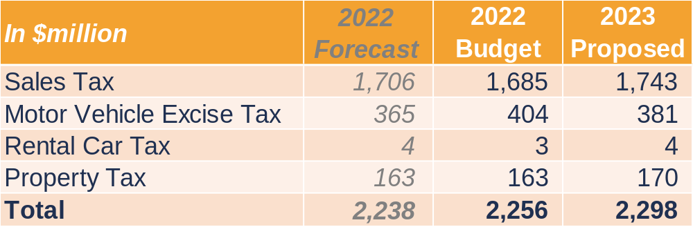
2023 tax revenues: $2.3B
*Numbers may not sum due to rounding.
    Sales and use tax is 65% of all 2023 total revenue and financing sources
    Total tax revenues 3% above 2022 forecast
Notes:
Sales tax increase of 3% over 2022B. The growth anticipated in 2023 has slowed due to the recent high levels of inflation but is still up comparing on a Y/Y basis.
MVET collections are projected to decline 6% to 2022 budget, however, is up compared to the 22 forecast from a recent revision to account for supply chain impact in the vehicle market;
Rental car tax projections are up slightly with an uptick in travel.
Property tax budget is based upon preliminary Assessed Value (AV) data and a 1% levy increase for 2023.
2023B vs 2022F
Sales tax increase of 2% over 2022 forecast. YTD collections for 2022 through June have trended down on a Y/Y increase over 2021. The growth anticipated into 2023 has slowed due to the recent high levels of inflation but is still up on a Y/Y basis.
MVET is up from a recently revised down forecast for 2022 as supply chains have impacted the vehicle market but are anticipated to improve in 2023.
Rental car tax projections are up slightly with an uptick in travel.
Property tax budget is based upon preliminary Assessed Value (AV) data and a 1% levy increase for 2023.
2023B vs. 2022B
$58M (3%) higher sales tax – Inflation is expected to continue into 2023. Inflation will cause higher prices leading to higher taxes, but could also temper growth if increased prices cause consumers to be more mindful of spending.
$23M (6%) lower MVET – Decrease in expected number of vehicle registrations.
$0.9M (31%) higher rental car – Increase in travel
$7M (4%) higher property tax – Based upon preliminary Assessed Value (AV) data and a 1% levy increase for 2023.
Projected Unrestricted Cash Balance as of 1/1/2023: $2,096,864,000
2022 YTD Tax performance over 2021 YTD Actuals (thru Aug):
Sales tax up 8%
MVET down 5% - Also contains the error. The actual results are closer to a 1%-2% YOY decline from 2021
RCT up 34%
Property tax up 4%

Slide 9
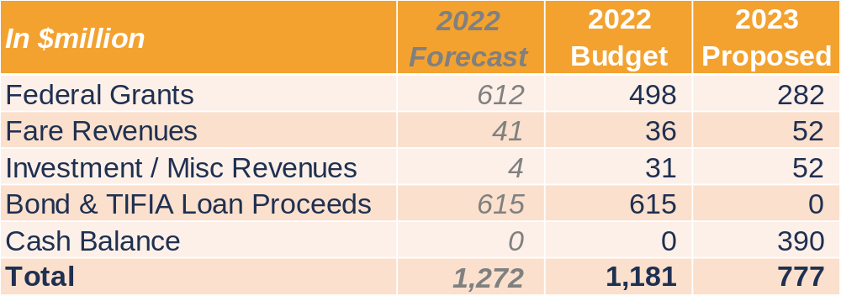
2023 other revenue & financing sources: $777M
*Numbers may not sum due to rounding.
    Federal grants lower in 2023 due to ARP funding in 2022
    Fare revenues increase with increased ridership
    Higher ORCA regional reimbursement
    No TIFIA draws currently scheduled
Notes:
Federal grants are projected to be lower mainly due to ARP funding in 2022 not in 2023 ($230M) in addition to LLE extension’s funding accelerated into 2022 ($74M).
Fare projections have increased due to a higher level of anticipated ridership.
Investment income is projected to increase ($27M) with higher interest rates projected offset by no Federal Build America bonds (BABS) subsidy budgeted for in 2023 due to uncertainty in the legislature regarding future funding ($6M).
No TIFIA draws assumed in 2023; we expect to utilize existing cash from recent draws in 2022 that will be carried forward into 2023 as timing of project spending has shifted from original 2022 budget. We manage our cash in alignment with our Asset and Liability Management Policy. (TIFIA stands for transportation infrastructure finance and innovation act)
2023B vs. 2022F
Federal grants are projected to be lower mainly due to ARP funding in 2022 not in 2023 ($230M) and LLE extension funding accelerated into 2022 ($74M).
Fare projections have increased due to a higher level of anticipated ridership.
2022 Investment income contains negative FMV adjustments that are not a part of the budgeting process.
ORCA reimbursement is projected to be higher with a full year of reimbursement in 2023 ($7.6M) and higher investment income offset by no Federal BABS subsidy budgeted for 2023 due to uncertainty in the legislature regarding future funding ($6M).
No TIFIA draws assumed in 2023, we expect to utilize existing cash from recent draws in 2022.
2023B vs. 2022B
$216M (43%) lower Federal Grants – No ARP funding in 2023
$16M (43%) higher passenger fares – Increased ridership expected, particularly on Link. Also, 2022 budget used a conservative ridership forecast
$27M (211%) higher investment income – Higher interest rates will lead to increased investment income
$6M (37%) lower Misc. - No budgeted Build America Bond Subsidy (BABS) due to uncertainty of future funding.
$615M (100%) lower TIFIA – No TIFIA draws are expected in 2023
ARP – American Rescue Plan
FFGA – Fully Funded Grant Agreement
2022 federal grants forecast:
2022 Year-end forecast of $612M, including:
$230M - Operations funding thru ARP – ($205 budgeted + $25M originally budgeted for 2021)
$123M - FWLE FFGA funding
$174M - LLE New Starts funding ($100M budget + $74M accelerated)
$25M - Downtown Redmond formula funding
$40M - Preventative maintenance
$20M - Other small grants
$612M Total
Federal Grants 2023 vs. 2022
Federal grants will be $330M lower in 2023 primarily due to the following funds from 2022 not being available in 2023:
$230M - 2022 ARP OPS (won't receive in 2023)
$74M - 2022 LLE FFGA - This $74M was accelerated into 2022. There is still $100M budgeted in 2023, but it will be $74M less than 2022.
$19M - 2022 Formula funds
$9M - 2022 Tacoma Link Small Starts
$330M Total
2023 federal grants budget:
$114M - Federal Way Link Extension
$100M - Lynnwood Link Extension
$25M - Downtown Redmond Link Extension
$27M - Light rail and bus preventative maintenance operating grants
$4M - Next Gen ORCA and LIFT
$3M - PIMS
$8M - Other small grants
$282M Total
Passenger Fares
14 million more riders expected in 2023 across all modes than 2022 forecast
11 million more riders expected in 2023 for Link than 2022 forecast
2022 Fare Revenue Budget was built off of total ridership of 20.2M boardings, 2023 Fare Revenue Budget is built off of total ridership of 37.8M boardings.

Slide 10
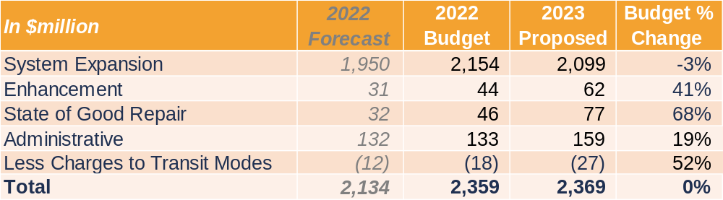
2023 projects budget: $2.4 billion
*Numbers may not add correctly due to rounding.
Notes:
*2022 Budget = 2022 Adopted Budget + adjustment from Board actions for Series 3 LRV, Puyallup Station Improvements, and NE 130th St. Infill Station projects​.
The proposed 2023 project budget is flat to 2022 budget at $2.3B, which is less than 0.5% change from 2022.
System expansion projects reduced by $55M, largely due reduction of $216.6M as Lynnwood Link and DRLE moved from their peak year of construction cost (in 2022), with increases driven mainly by 3 projects
$99.4M TDLE – Preparing for ROW activities and advancing design (OMFS) and continuing to advance DEIS (TDLE).
$97.6M I-405 BRT – Anticipate baseline in Q2 2023. , Complete Final Design, initiating procurement of systems and vehicles and continuing ROW acquisition and construction.
$50M WSBLE – Begin Ph3 PE and ROW activities.
Non-System Expansion projects (NSEP) increased by $66M, with $27M of new NSEP projects from new projects, and $48M increase change to existing projects off set by $(9)M going to transit modes.
Enhancement projects increased by $18M from 2022 budget with $12M for the new Portfolio Services Office Programmatic Work to support all agency-wide projects with engineering and station standards efforts.
State of good repair increased by $31M from 2022 budget. $6.5M comes from DSTT capital improvement activities, $4.2M for IT Tech infrastructure to upgrade servers at the data centers, and $3M for the vertical conveyance program to proceed with assessment and design of replacement elevators at Auburn, Kent and Everett stations.
Administrative projects are increasing $26M from 2022 budget with $21.3M increase mainly due to the impact of inflation, staffing , $3.1M in IT program to continue to address agency’s needs for IT systems, and $1.7M for office decommissioning.
Lastly, charges to transit modes is a reduction to the projects for non-capitalizable expenses in various projects that are in support of the transit modes. Examples include Sounder Vehicle Overhaul, Link Overhaul, DSTT program planning.
System Expansion decreased by 3% or $55M
Change to existing projects
$(152.2)M LWL – 2022 was the peak year of construction cost, project anticipates reaching substantial completion on both GCCM contracts in 2023 as well as other activities to include commissioning and testing.
$(64.4)M DRLE – 2022 was the peak year of construction cost, construction continues guideway and track work, stations and South Redmond Garage
$(56.2)M HTLE – Planned for commencing revenue service in Q1 2023 and transition to project close out activities focused on transitioning to Operations ownership.
$99.4M TDLE – Preparing for property acquisition (OMFS). Advance design and DEIS for S. Federal Way alignment (TDLE).
$97.6M I-405 BRT – Anticipate baseline in Q1 2023. Complete Final Design and continue construction
$50M WSBLE – Begin Ph3 PE and ROW activities.
New projects - Project initiation to meet revenue service date
$4.1M Boeing Access Rd Infill
$1.9M Dupont Extension
$1.7M Graham St Infill
ENH increased by 41% or $18M
New projects approved in 2023 @$19.7M
$12M PSO programmatic Work to unify processes within the agency.
Change to existing projects @$1.7M
Largest increase $3.3M from Seatac Airport second elevator to begin installation of elevator
Largest decrease $(2.2M)from PIMS accounting for missed 2022 milestones and updated schedule.
SOGR increased by 68% or $31M
Change to existing projects @$23.7M
Increase of $6.5M from DSTT to begin construction at the receipt of the tunnel
Increase of $4.2M from IT Tech Intrastructure to replace/upgrade services at data center.
Increase of $3M from VC program to perform assessment and design replacement for Kent, Auburn and Everett Stations.
Increase of $2.5M from IT network redesign for Brocade replacement and security design implementation.
Increase of $2.4M from Kinkisharyo LRV system upgrade to begin upgrade as contract negotiations finalized in 2022
New projects approved in 2023 @$7.3M (Top 3)
$2.1M for ST1 LRV APSE Overhaul to purchase Auxiliary Power Supply Equipment (APSE) for KI cars, get consulting services to support the project including APSE replacement design.
$1M for EAMS replacement assessment – performed in conjunction with ERP assessment.
$0.8M for ST1 LRV Propulsion upgrade to begin RFP for replacement of end of life propulsion container.
ADM increased by 19% or $26M
Change to existing projects @$23.7M
$21.3M increase in Agency Admin operating (overheads) with higher inflation rate and increased FTE in 2023.
$3.1M increase in IT Program to continue work on new 2023 requests as well as 2022 delayed activities.
$1.7M increase in Admin Services for office decommissioning
============================================
COMPARISON to 22F:
System Expansion increased by 8% or $149M
Largest variances comparing to 2022 forecast
I405 BRT increased by $121.6M – Anticipate baseline in Q1 2023. Complete Final Design and continue construction
***TDLE increased by $109M – Preparing for property acquisition (OMFS). Advance design and DEIS for S. Federal Way alignment (TDLE).
WSBLE increased by $53M – Begin Ph3 PE and ROW activities.
Lynnwood Link Extn decreased by ($71M) - 2022 was the peak year of construction cost, project anticipates reaching substantial completion on both GCCM contracts in 2023 as well as other activities to include commissioning and testing.
East Link decreased by ($57M) – Passed peak of construction.
ENH increased by 99% or $30.6M
2022 Performance forecasted to close at 71% of Budget ($12.6M)
PIMS $7.6M – vendor delivery date delayed from 2022 to 2023 for several milestones.
LINK OMF $0.8M – generator’s design is taking longer than anticipated
LED lighting program delayed $0.5M due to track access availability and delay in light fixtures delivery.
$1M video management system upgrade lacking IT resources to support the project. Video analytics portion of project will be deferred.
New projects total $19.7M cashflowed in 2023
$12M PSO programmatic work– support for all agency-wide projects – examples of projects engineering standards, stations standards
$1M Subject matter expert for Link System Expansion related efforts – consultant driven
$0.9M Systemwide SCADA (supervisory control and data acquisition) BMS (bldg mgmt sys) integration – consultant driven
$0.6M At Grade warning signs – components of an At Grade program.
Largest variances comparing to 2022 forecast $10.9M
PIMS increased $5.4M from forecast accounting for the underspending in 2022 for continued activity on PIMS. 2023B is appropriately budgeted and any underspending at the end of the year will NOT roll into 2023.
SeaTac airport station 2nd elevator increased $3.2M – continued construction
Clink Tie switch Installation increase $1.4M – begin installation
SOGR increased by 139% or $44.6M
2022 Performance forecasted to close at 70% of budget ($13.5M)
$4.8M from Sounder Veh Overhaul pending new car procurement delivery, testing and commissioning.
$1.4M from DSTT CIP improvements having challenges approving design causing delay in construction.
$1.4M from Link LRV Overhaul with limited labor availability
$1M from KI LRV system Upgrade as project is in contract negotiation
New projects total $7.3M in 2023
$2.1M in ST1 LRV APSE (Auxiliary Power Supply Equipment) overhaul – to replace APSE on ST1 trains – they are at the end of life.
$1M in EAMS replacement study – Assessment on system in concert with ERP research.
$0.8M for ST1 LRV Propulsion Upgrade – to upgrade propulsion system on ST1 trains – they are at end of life
$0.6M for Issaquah TC site improvement –repairs and improvements to the TC, includes rusted gate, repainting, resurfacing, gutters, and roofing.
Largest variances comparing to 2022 forecast $37.3M
$7.9M DSTT Capital improvements – continued work on DSTT improvements.
$7M Sounder Overhaul - Continued work on coaches including HEP replacements.
$4M IT Tech Infrastructure – Upgrade servers, work stations and laptops.
$3.9M VC Program – continued work on DSTT stations VC. Additional funding is expected to be requested for when quote is finalized for the replacements of VCs in the stations in DSTT.
$3.3M Kinkisharyo LRV Sys upgrade – Contract finalized with higher costs. Project proceed to replace and update onboard communications.
$2.3M IT Network redesign – continue brocade replacement and security design implementation.
$1.8M Pierce Transit CAD AVL (Computer-Aided Dispatch / Automatic Vehicle Location) replacement - Installation on pilot buses for testing. Complete installation after testing.
$1.7M ERP research – begin consultant search
ADM increased by 21% or $27.2M
2022 Performance forecasted to close at 86% of budget ($1.3M – w/o agency admin operating 0X002)
$1.1M from Admin facilities due to longer lead times for special order of HVAC rooftop equipment and secondary engineering report for crane replacement.
$0.7M from Admin pool vehicles – Lack of computer chips which delayed production and shipment.
No new projects are established in Admin (IT program closed out projects completed prior to 2021. This does not have impact on the annual view because there’s no longer cashflow. Change seen in project allocation $18.9M less)
Largest variances comparing to 2022 forecast $27.2M
Agency Operating Admin increased by $21.7M
$14.5M from S&B cost escalation and market adjustment
$4.9M from estimated 29 (out of 91) new FTE added to 2023 budget based on average S&B of $170K per annum.
$2.3M estimated based on CPI 4.58% non S&B cost escalation.
IT program increased $3.2M – continuation of various projects
Admin Services increased by $1.7M for office decommissioning.
“Less charges to Transit Operating” Excludes expense projects that support the operating of modes ($12M in 2022 forecast and $27M in 2023 proposed)

Slide 11
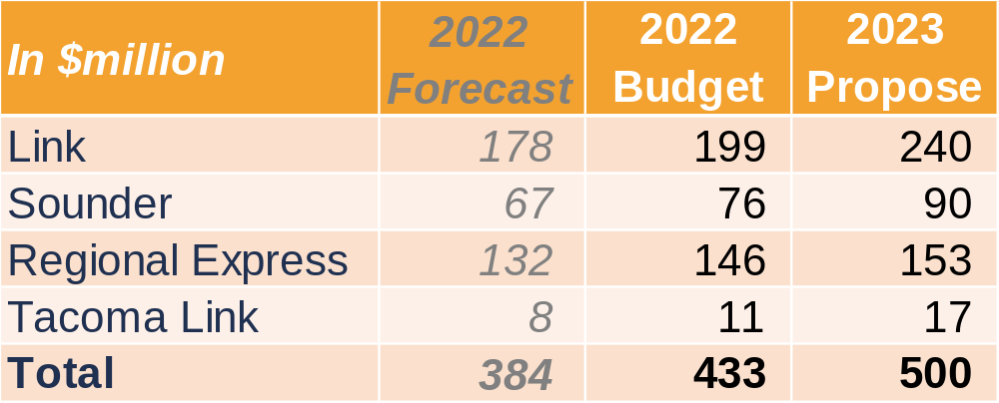
2023 transit operations: $500.1M
*Numbers may not add correctly due to rounding.
Link: increase in Purchased Transportation services, spares, consulting and security
Sounder: recovery of South trips, increase in fuel rate, maintenance, and vehicle overhaul
ST Express: increase in fuel rate and partner operating cost escalation
Tacoma Link: Tacoma Hilltop service begins
Notes:
Overall the proposed 2023 transit operating budget increased by 15% or $67M growth over the full-year 2022 Budget.
At a high level across modes –
Activation and service restoration comprises 6% or $24.3M of the increase driven by:
$9.2M for service restoration for STX (PTS adjustment bringing STX to planned service levels)
$7.1M new FTE in activation and service restoration
$5.1M for Increase in Link service levels
$2.9M from Hilltop Tacoma Link Extension
Cost escalation is driving 5% or $21.1M of the increase driven by:
$7.8M overall cost escalation in Services (including a $4.7M largely from security and safety services);
$5M escalation in S&B
$3.9M Link Purchased Transportation 5% cost increase
$3.4M Sounder fuel cost increase from 3.20 to 5.00 per gallon.
State of good repair and other maintenance is contributing 3% or $14.8M driven by:
$7.7M from increase in expense/operating projects
$7.1M from spare parts and facilities maintenance
Insurance and other is driving 1% or $2.7M of the increase mainly from Northgate valuation and Link and Sounder vehicle increases.
DEIC comprises 1% or $4.8M for additional headcount for fare ambassadors and funding for engagement and outreach work. ($2.3M is in S&B)
Link increased $40M, mainly due to Purchased Transportation, security, spare parts, and insurance.
Sounder increased $14M due to filling of vacancies expected in 2023, additional dollars for vehicles and facilities maintenance, and fuel costs.
Regional Express increased $7M mainly due to Purchased transportation with an increase in partners rates and higher fuel costs.
Tacoma Link increase of $6M is to account for revenue service of Hilltop Tacoma Link Extension in 2023.
*2022 budget includes budget adjustments allowed under R2020-24 Budget Policy Section 3.4.2
$9.1M adjustment from PTS to Agency contingency to cover prior year PTS credit to account for equivalent impact to the budget from the credit received.
=======================
Adtl informational detail:
Link $40.5M increase:
$14.7M PTS – $3.9M 5% inflation, $2.9M electro mechanics not eligible for startup, $2.4M due to PY recon, $1.5M increase in OT, $1.3M expanding system task orders/adtl O/H support/supplies, $0.9M 9 mth OMFE staff no covered in startup
$5.4M expense projects – 8 new projects, DSTT
$4.9M spares – for new fleet and existing aging fleet
$3.6M link consulting costs – bridge, tunnel work, expanding system unknowns
$3.0M security & safety - inflation
$2.0M insurance – higher NGLE valuation
$1.5M S&B increases (include filling vacancies)
$5.4M non-S&B cost escalation ($1.3M PY recon) – i.e. - plug for all the small increase, no large drivers such as those listed above
Sounder $13.5M increase:
$3.4M fuel Amtrak fuel at $5.00 per gallon (from $3.20 p/g)
$2.4M expense projects - overhaul
$2.2M vehicle & facilities maintenance – escalations + increased service levels
$1.9M agency o/h (higher agency-wide S&B-4% merit, 2.75% reclass, 2% salary adj)
$1.4M S&B increases (include filling vacancies)
$1.3M non-S&B cost escalation
$0.9M spares – escalations + increased service levels
Regional Express $7.0M increase:
$9.2M PTS ($5.4M PY recon) – increase in platform hours, gas at $5 per gallon
$0.9M facility maint
($0.8M) fare vending
($0.6M) expense projects
($0.5M) decrease in S&B (including filing vacancies)
($0.6M) other
Tlink $6.1M increase - assumes HTLE opening ~Q1 2023:
$1.5M loss of startup labor capitalization - HTLE
$1.0M increase in S&B- HTLE
$1.0M security & safety- HTLE
$0.4M spares and equipment- HTLE
$0.3M insurance- HTLE
$0.3M new facilities- HTLE
$0.3M agency o/h (higher agency-wide S&B-4% merit, 2.75% reclass, 2% salary adj.)
$0.3M expense projects- HTLE
$0.2M utilities- HTLE
$0.8M other

Slide 12
2023 budget and Transit Improvement Plan recommendations
Long-Range Financial Plan Projections 2017 - 2046
Including Sound Move, ST2, and ST3 sources and uses through 2046
Transit Improvement Plan to 2028
Board-approved costs for active projects through 2028
Budget 2023
Annual revenue, financing sources and expenditures for 2023

Slide 13
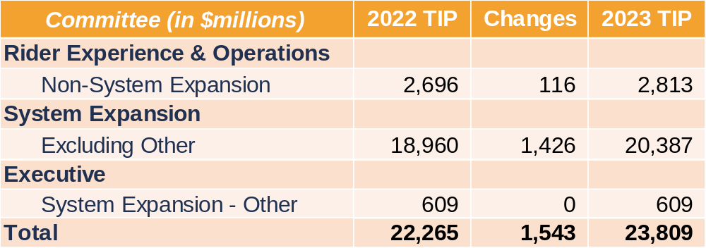
2023 Transit Improvement Plan: $23.8 billion
Board-approved costs for active projects
Note: Numbers may not sum due to rounding.
Notes:
This slide provides a summary of the changes in the TIP as a result of the Proposed 2023 budget and rolling the TIP forward an additional year.
The TIP represents not just the annual proposed amount but the total through 2028 to complete the milestone(s) in future years.
The total change in the TIP is $1.5B.
The majority of the increase is driven by –
Adding an additional year to the administrative operating project, which shows up in the Non-System Expansion line
Dollars forecasted for ROW purchases for WSBLE and TDLE
Final design and construction on BRT projects
In addition, the NE 130th ST. light rail project had additional dollars added to future years during a 2022 budget action back in June
SYSTEM EXPANSION
Largest increases by are in existing project with changes.
17 projects in total has changes to project allocation (reminder that this is not the annual budget).
Added to the TIP that is NOT because of the 2023 Budget –
Majority of these project has completed that initial preliminary engineering/assessment work and ready with estimates to continue PE, FD procurement and ROW acquisitions and construction.
Link – The WSBLE project increased by $569M and in separated into 2 projects after completion of the initial PE work. Ballard Link and WS Link Extensions has separate revenue service dates.
Ballard Link increased by $343.9M for the procurement of DB project management and ROW. The preferred alternative has been identified by project team pending Board’s approval. The increase in TIP is requested to begin early property acquisitions to maintain schedule and reduce risk. Property cannot be purchased, except protective acquisitions before the Record of Decisions which is an action that the Board must take.
West Seattle link project is established at $225M to continue the preliminary engineering phase, prepare FEIS; support project to be built determination; and final design procurement. The increase in TIP is requested now upon decision of the delivery method, the increase will procurement of DBPM plus for RFP and requirements documentations.
Link - TDLE $172.7M to predominantly fund commencement of property acquisition on OMF: South, and support the extension of TDLE Phase 2 (authorized via Board action in Fall 2022). There are plans to separate the projects in 2023.
OMFS is requesting TIP now upon decision of the delivery method. OMFS plans to proceed to Phase gate for DBPM and publish FEIS procurement in first half of 2023 and select project to built in the second half. Funding and phase gates are not connected.
TDLE is requesting for TIP now as the project has currently better information and estimates to proceed with the protective acquisition. (and with a willing seller the project team wants to be able to act quickly.)
BRT- Bus base north increased by $219M to fund an additional year of staff time, Final Design, procurement of Bus Base North construction and some Construction UAC. Baseline is anticipated in early Q2, however, with phase gate independent of funding, the increase in TIP is requested during the budget cycle to reduce schedule risk. The project intends to begin the construction procurement late 2023.
Added to the TIP because of the 2023 Budget
BRT - I-405 BRT increased by $162.4M to fund an additional year of staff time, final design, WSDOT Agreement for Tukwila International Blvd. Station, ST contribution to City of Renton Park & Ride, re-establish construction unallocated contingency, and vehicle procurement.
Sounder – Sounder South Capacity Expansion increased by $13.7M for the following activities:
$2.4 million for King Street Station Platform Area Improvements for conceptual engineering, environmental assessment, BNSF coordination, and ROW activities.
$5.4 million for the TR Junction to Portland Ave. track improvements for conceptual engineering, environmental assessment, and preliminary engineering.
$6.0 million for S. 66th St. Bridge to Pine Street track improvements for conceptual engineering, environment assessment, and preliminary engineering.
3 projects increased funding in 2022 via the respective board actions $240M
$3.25M to increase project allocation to complete construction and changing service date from Feb 2022 to Q4 2022 (R2022-10)
$33M to establish the Series 3 LRV project (R2022-12)
$203.7M to establish baseline for the NE 130th Street Infill Station (R2022-17)
1 project closure $40M
Tukwila Station $40M
3 new projects $20M
Dupont Extn increased by $8.6M for project initiation which include conceptual engineering and environmental for track & signal improvements (e.g. second main track). Develop and execute third-party agreements for planning phase only with railroad organizations that operate on Sound Transit’s rail corridor.
Boeing Access Rd Infill Station increased by $8.6M to initiate project, which include alternatives analysis, conceptual engineering, and environmental evaluation for the infill station.
Graham St Infill Station increased by $2.9M to initiate project, which include alternatives analysis, conceptual engineering, and environmental evaluation for the infill station.
22 existing projects with no changes amounting to $17.1B
NON SYSTEM EXPANSION
Major changes are as follows:
21 existing projects have changes in the amount of $129M mainly contributed by
- Agency Administrative Operating project by $128.2M increase for anticipated agency administrative operating costs from 2023 to 2028 with updated projections and by adding an additional year to 2028, offset by a $302.5 million decrease with removal of costs through 2016 prior to ST3.
- Engineering Services Program of $6.0M to add funding for additional 2 years of inter-departmental engineering services for operations work activities.
10 closed projects in the amount of $82M
ENHANCEMENT (7 projects)
Positive Train Control $43.1M Integrate command, control, communications, and information systems for controlling passenger train movements with safety, security, precision, and efficiency. These systems will improve railroad safety by significantly reducing the probability of collisions between trains, casualties to railway workers and damage to their equipment, and over speed accidents.
Bus Maintenance Facility $22.0M – changed methodology to fund contributions to the bus maintenance facility. i.e. from program to via the IGA.
SOGR (3 projects)
Link CCTV System Upgrade $3.1M
29 new projects
SOGR (16 projects)
PSO Programmatic work $13.5M for unification work.
SME for Link SYX related work $6M for consulting work
ENH (13 projects)
ST1 LRV Propulsion upgrade $20.0M for upgrade.
ST1 LRV APSE Overhaul $9.3M to replace Auxiliary Power Supply Equipment (APSE)
82 existing projects have no changes to its authorized project allocations amounting to $864M.

Slide 14
Timeline
October – budget and Financial Plan kickoff
10/27 – Board Meeting – Overview of Long-Range Financial Plan projections and budget
November – budget overview and property tax levy approval
11/3 – Public hearing – budget and property taxes.
11/3 – Executive Committee – budget overview and property tax levy
11/3 – Rider Experience and Operations Committee – budget overview
11/10 – System Expansion Committee – budget overview
11/17 – Board Meeting – request for approval of the property tax levy

Slide 15
Timeline continued
December – budget recommendation and approval
12/1 – Rider Experience and Operations Committee – recommends to FAC
12/8 – Executive Committee – recommends to FAC
12/8 – System Expansion Committee – recommends to FAC
12/15 – Finance and Audit Committee – recommends to Board
12/15 – Board – adoption of the Proposed 2022 Budget and Transit Improvement Plan

Slide 16
Notes:
CLOSING STATEMENT: “This concludes my presentation, I would be happy to answer any questions.”

